Slide 1

WORLD POPULATION INFERENCES
BY
VENIS C

Slide 2
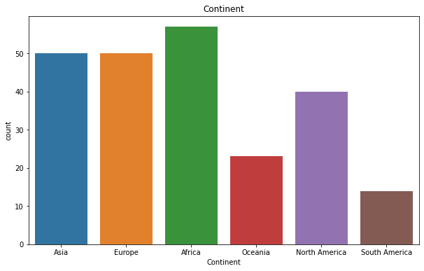
Continents

Slide 3
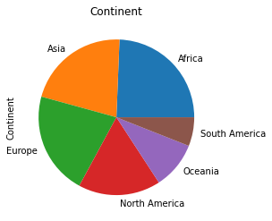
Continents in pie chart

Slide 4
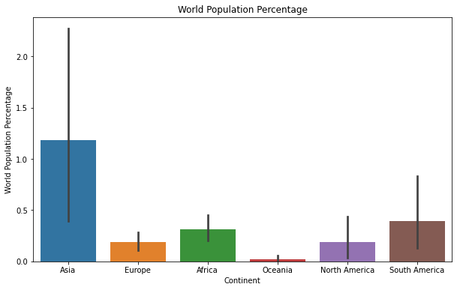
World population percentage

Slide 5
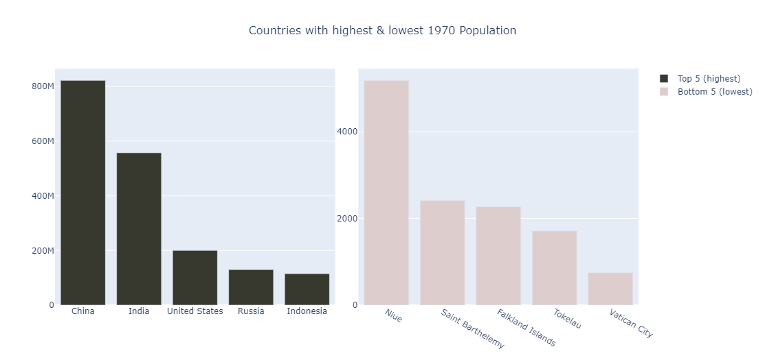
World population 1970

Slide 6
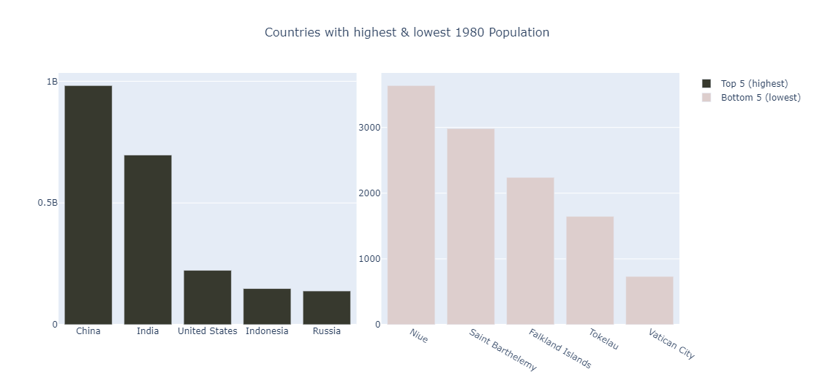
World population 1980

Slide 7
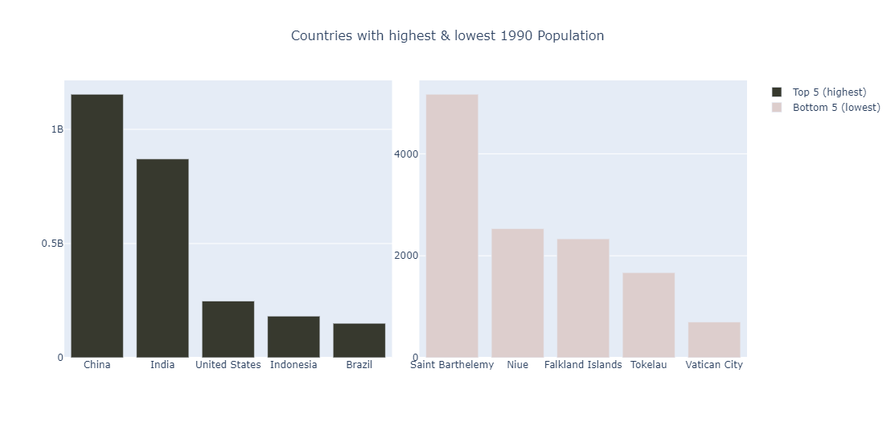
World population 1990

Slide 8
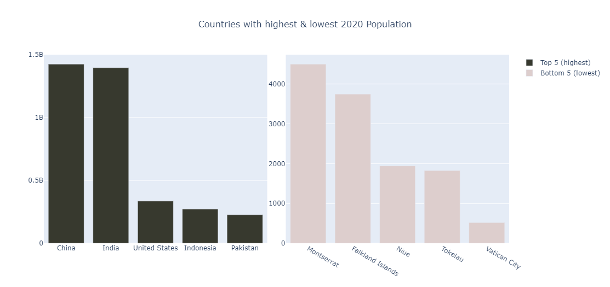
World population 2000

Slide 9
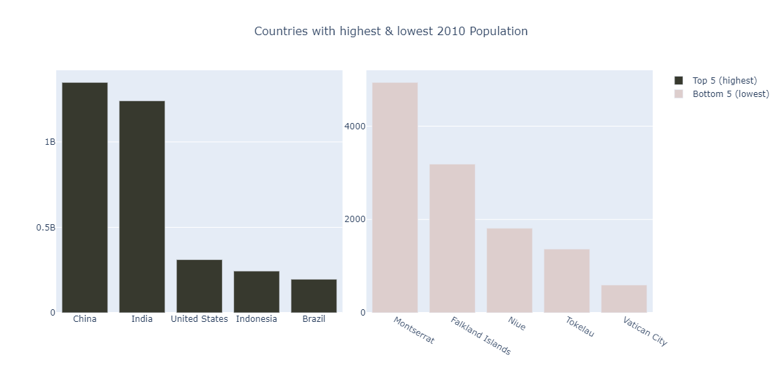
World population 2010

Slide 10

World population 2015

Slide 11
World population 2020

Slide 12

World population 2022

Slide 13


